Slide 1
E-Learning Platform
Group No – GB 22
Team Members:-
Prajjwal Yadav
Prachi Sharma
Priyanka Pandey
Under the supervision of :-
Dr. Shashank Bhardwaj
Department Of Computer Applications
KIET GROUP OF INSTITUTIONS
DELHI-NCR,
GHAZIABAD ( 2023- 2024)

Slide 2
Project Progress
We've attached the project progress presentation alongside screenshots displaying the completed modules.
These images offer a visual depiction of the modules available for review, offering a thorough overview of the strides taken in the development phase.
They emphasize the functionality and features integrated up to this point in the process.

Slide 3
Completed modules of the project
01.
02.
Home
Registration
03.
04.
05.
Courses
Admin Panel
Contact, Feedback
>
<
>
<
<
<

Slide 4

HOMEPAGE

Slide 5
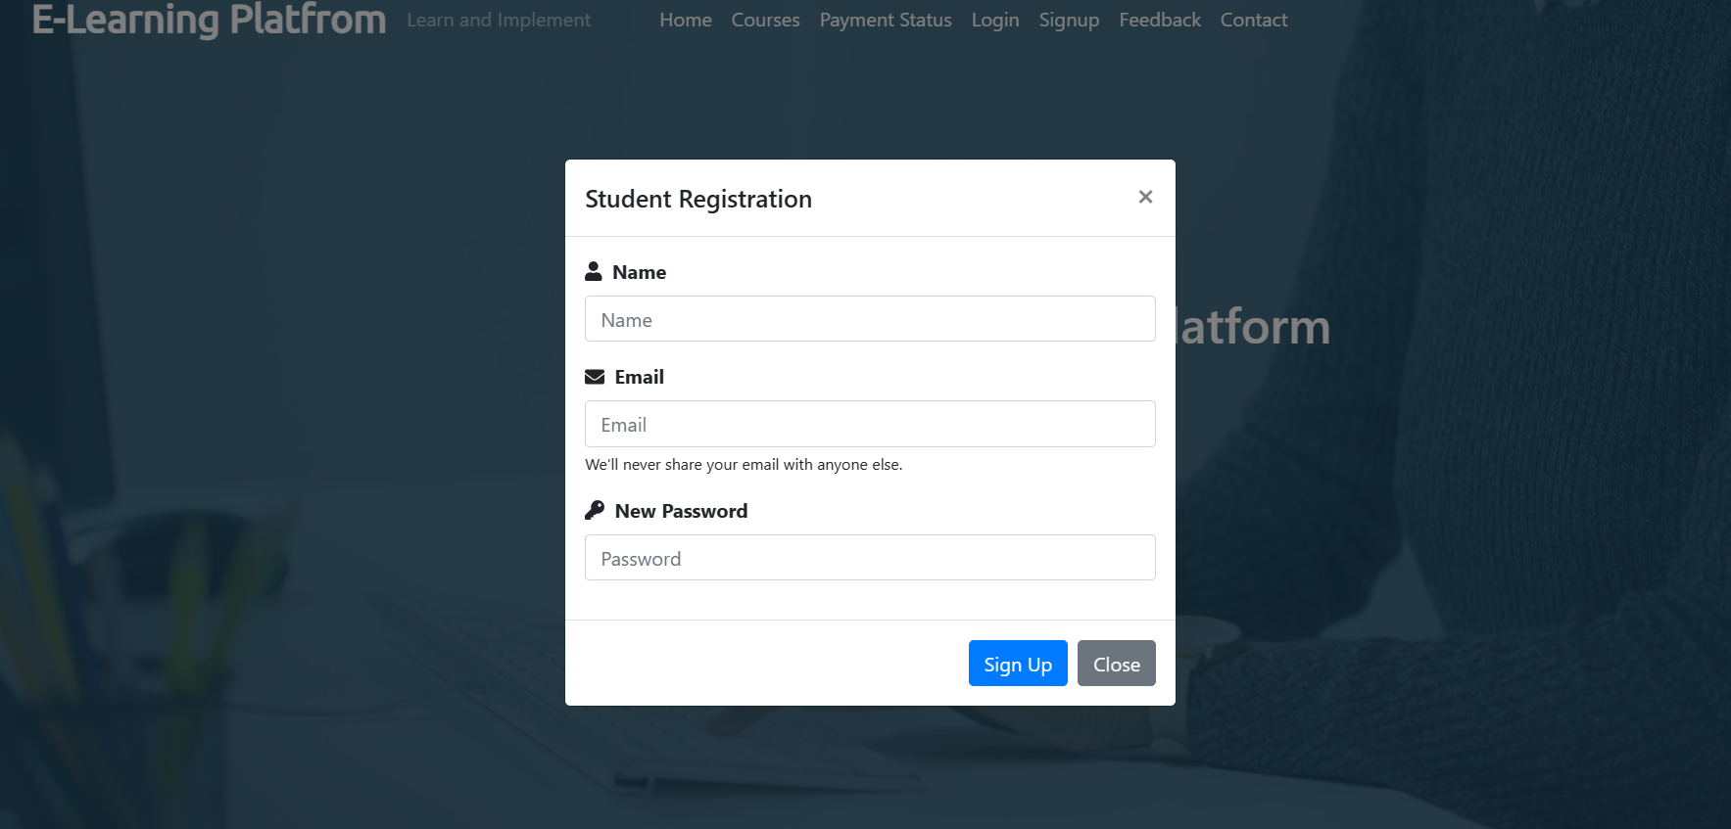
REGISTRATION

Slide 6
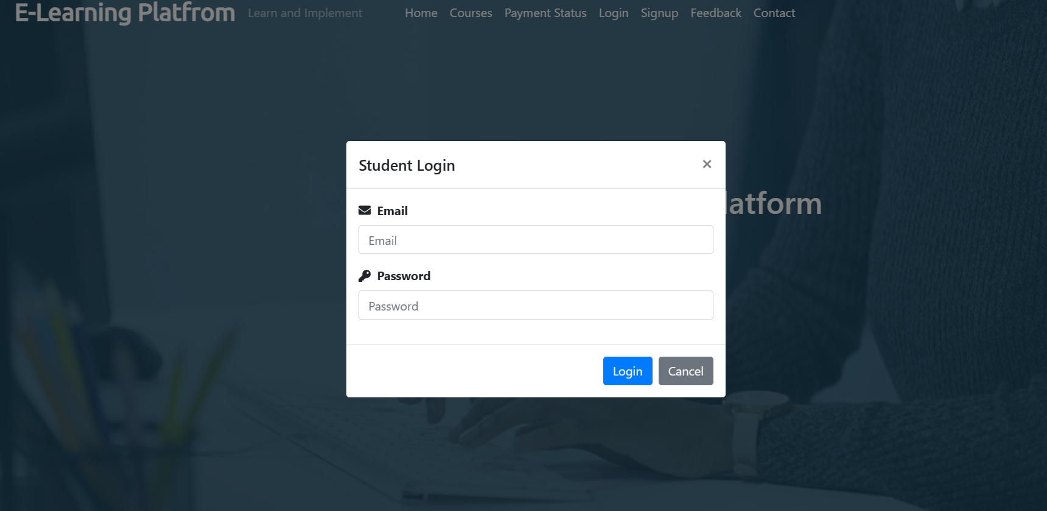
LOGIN

Slide 7
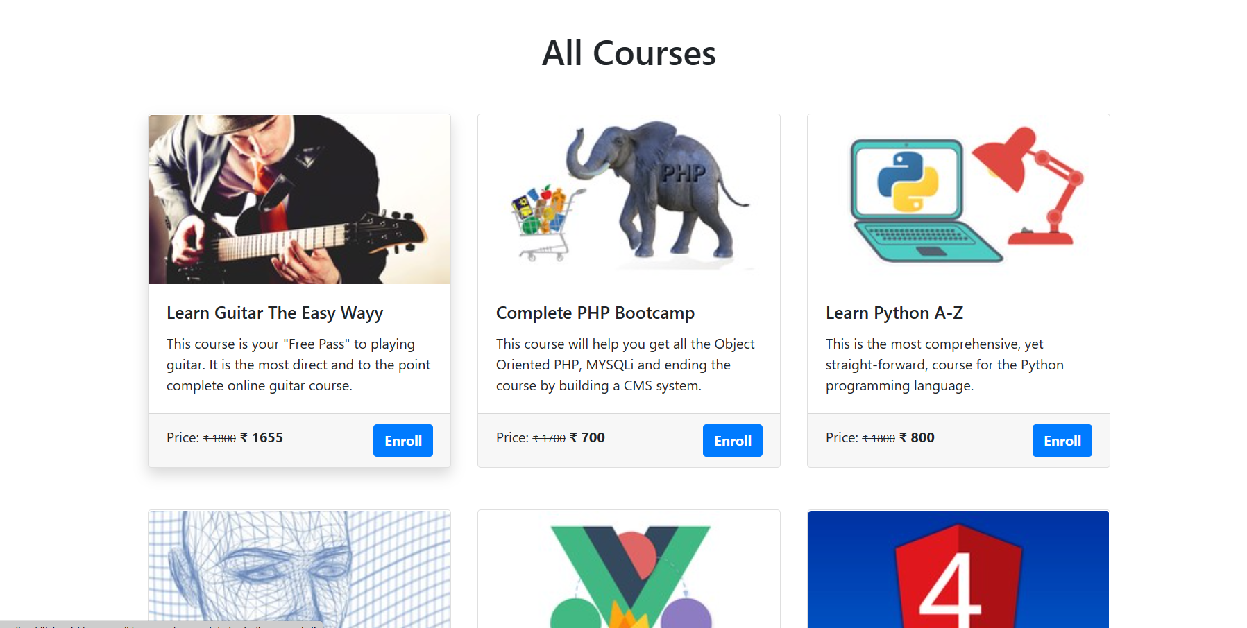

COURSES

Slide 8
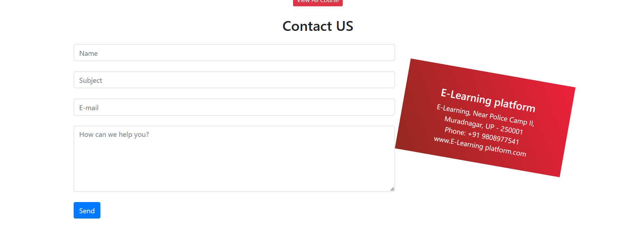
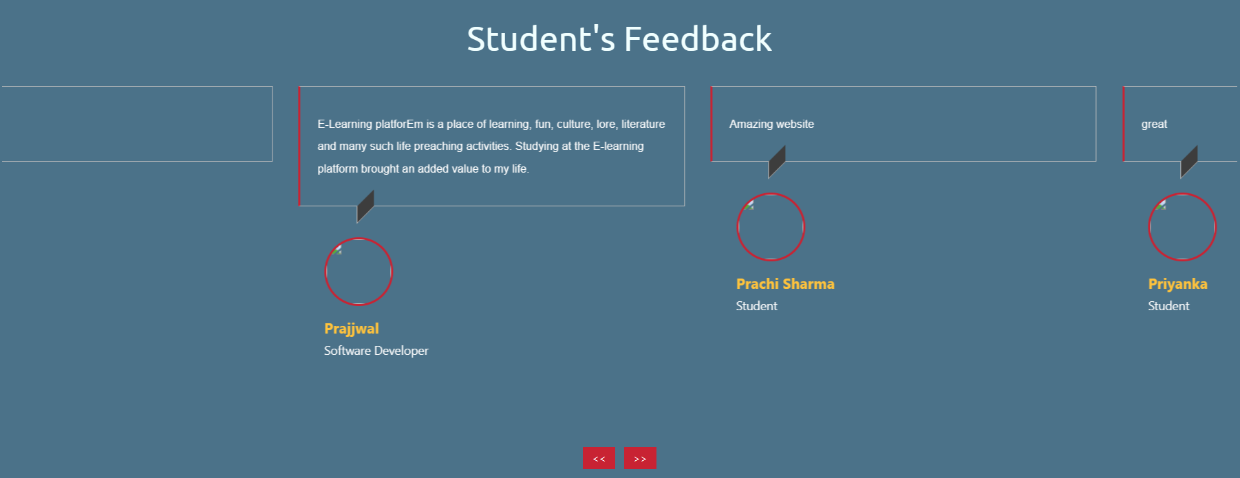
CONTACT, FEEDBACK

Slide 9
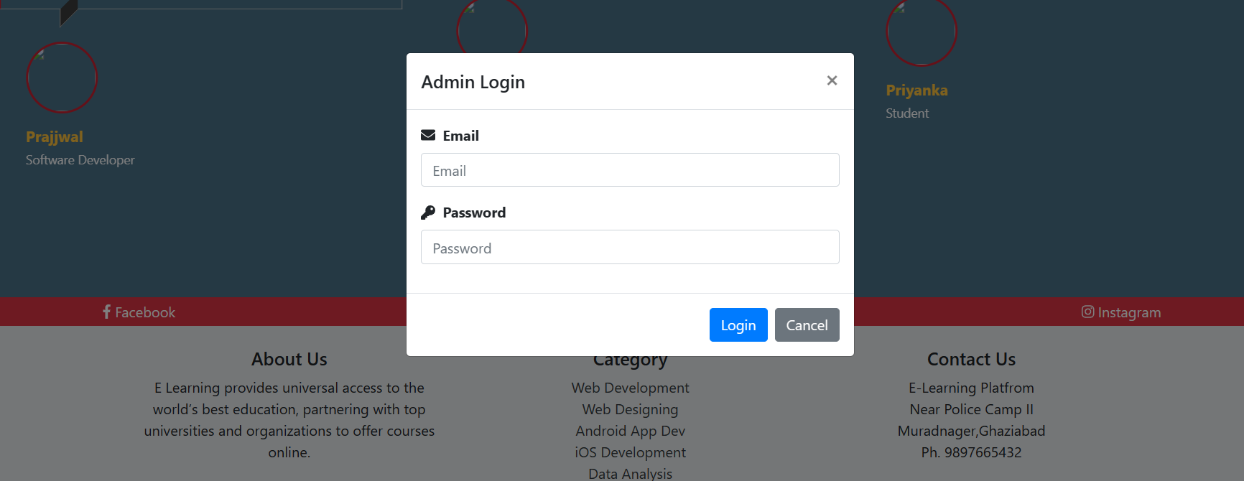
ADMIN PANEL

Slide 10
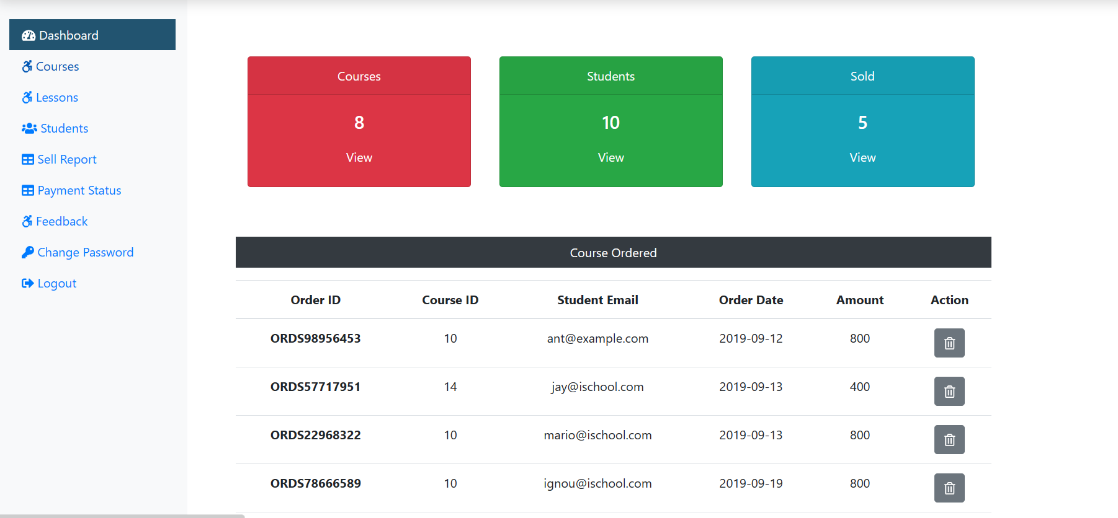
ADMIN PANEL

Slide 11
WHY NEEDED
1. Accountability: It holds team members accountable for their tasks and deadlines by showcasing what has been achieved and what still needs to be done. 2. Feedback: It allows for early feedback, enabling adjustments to be made if necessary, before significant time and resources are invested in the wrong direction. 3. Motivation: It boosts team morale by acknowledging progress and milestones achieved, motivating team members to continue working towards the project's success. 4. Communication: It facilitates effective communication among team members, ensuring everyone is aligned with the project's objectives and timelines. Overall, presenting a progress report not only ensures project success in terms of schedule, satisfaction but also contributes to improved risk management, resource optimization, quality assurance, and documentation practices.

Slide 12
THANK YOU

